Slide 1
Production of radioactive ion beams and light exotic nuclei study at the ACCULINNA-2 separator
Supervisor:
Participants:
Aleksandra Świercz (Flerov Laboratory of Nuclear Reactions, AGH University of Science and Technology)
Luca Mihăilescu (University of Bucharest)
Patryk Jaroś (University of Bialystok)
International Student Practice - Dubna, 26.07.2019

Slide 2
Aim of the practice
Familiarizing with experiment preparation & data analysis
Learning about the ACCULINNA-2 separator
Performing simulations for particle separation

Slide 3
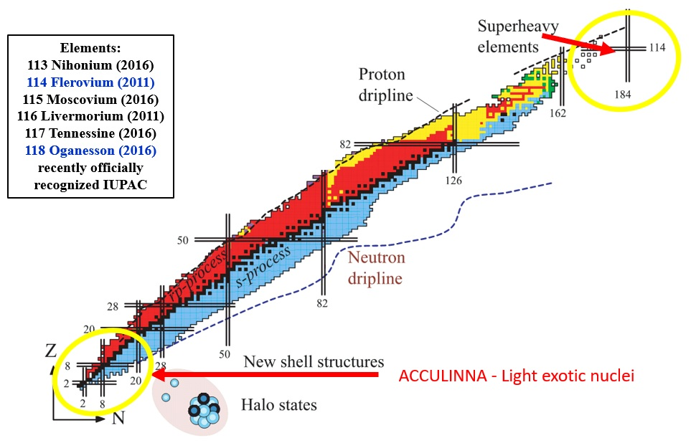
Nuclide chart

Slide 4
Light nuclei Exotic nuclei
Because of:
Small number of protons and neutrons.
Because of:
Far from path of stability.
Unstability (short time of life).
Do not exist in the nature.
They are produced during nuclear reactions.

Slide 5
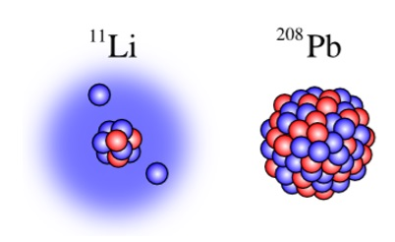
Phenomena at the border of stability
New types of radiation: decays with emission of one or a few protons (2p, 3p).
Halo nuclei - core nucleus is surrounded by a ‘halo’ of orbiting protons or neutrons = radius of the nucleus seems to be larger than in reality.

Slide 6
Equipment

Slide 7
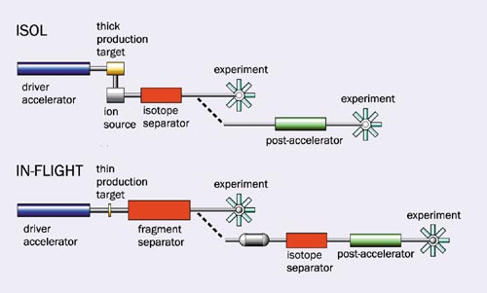
How to obtain radioactive ion beams?

Slide 8
ACCULINNA
Operating since 1996
High intensity primary beams of 7Li, 11B, 13C, 15N and 18O
Energy values ranging between 32 and 50 AMeV are delivered by the U- 400M cyclotron to the production target of the separator.
Secondary beams of 6He and 8He nuclei with energies of about 25 AMeV
Produced new insights into the structure of neutron halo nuclei through the study of one- and two-neutron transfer reactions made with hydrogen and helium targets.
Favorable conditions for the production of so far unknown particles -- unstable nuclei beyond the neutron drip line.

Slide 9
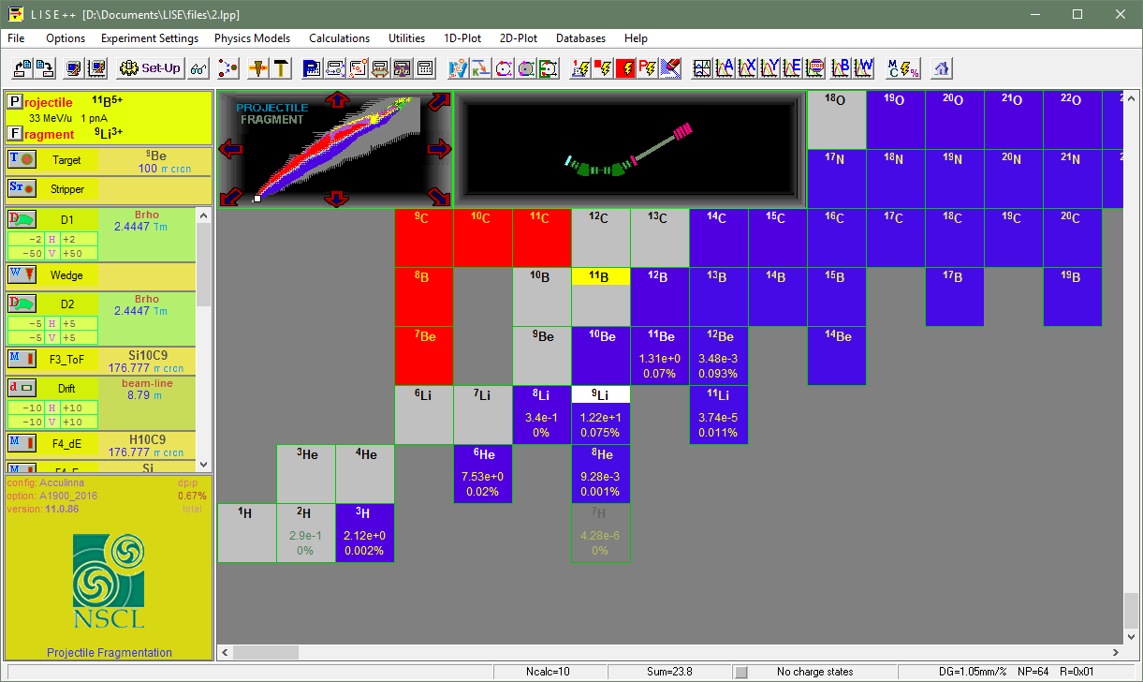
Simulation of ACCULINNA configuration using LISE++

Slide 10
ACCULINNA-2

Slide 11
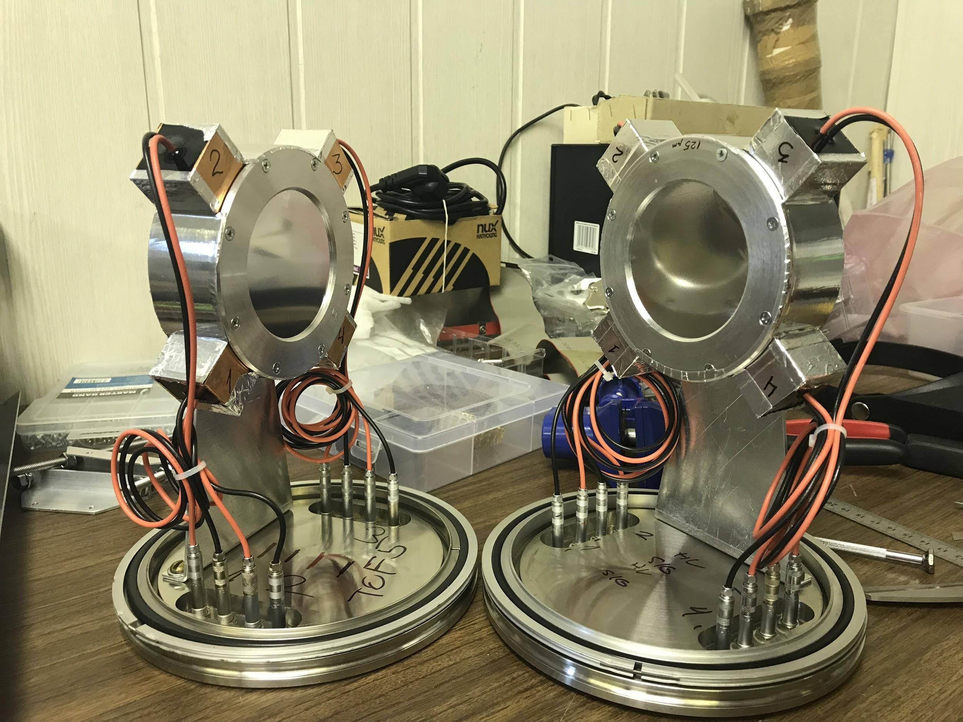
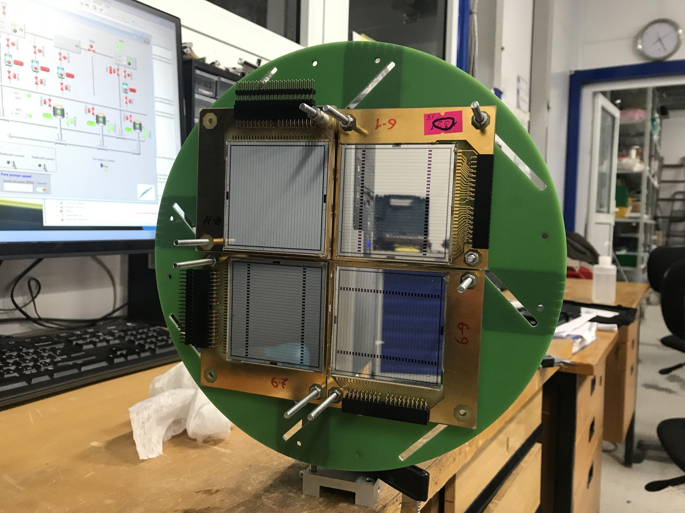
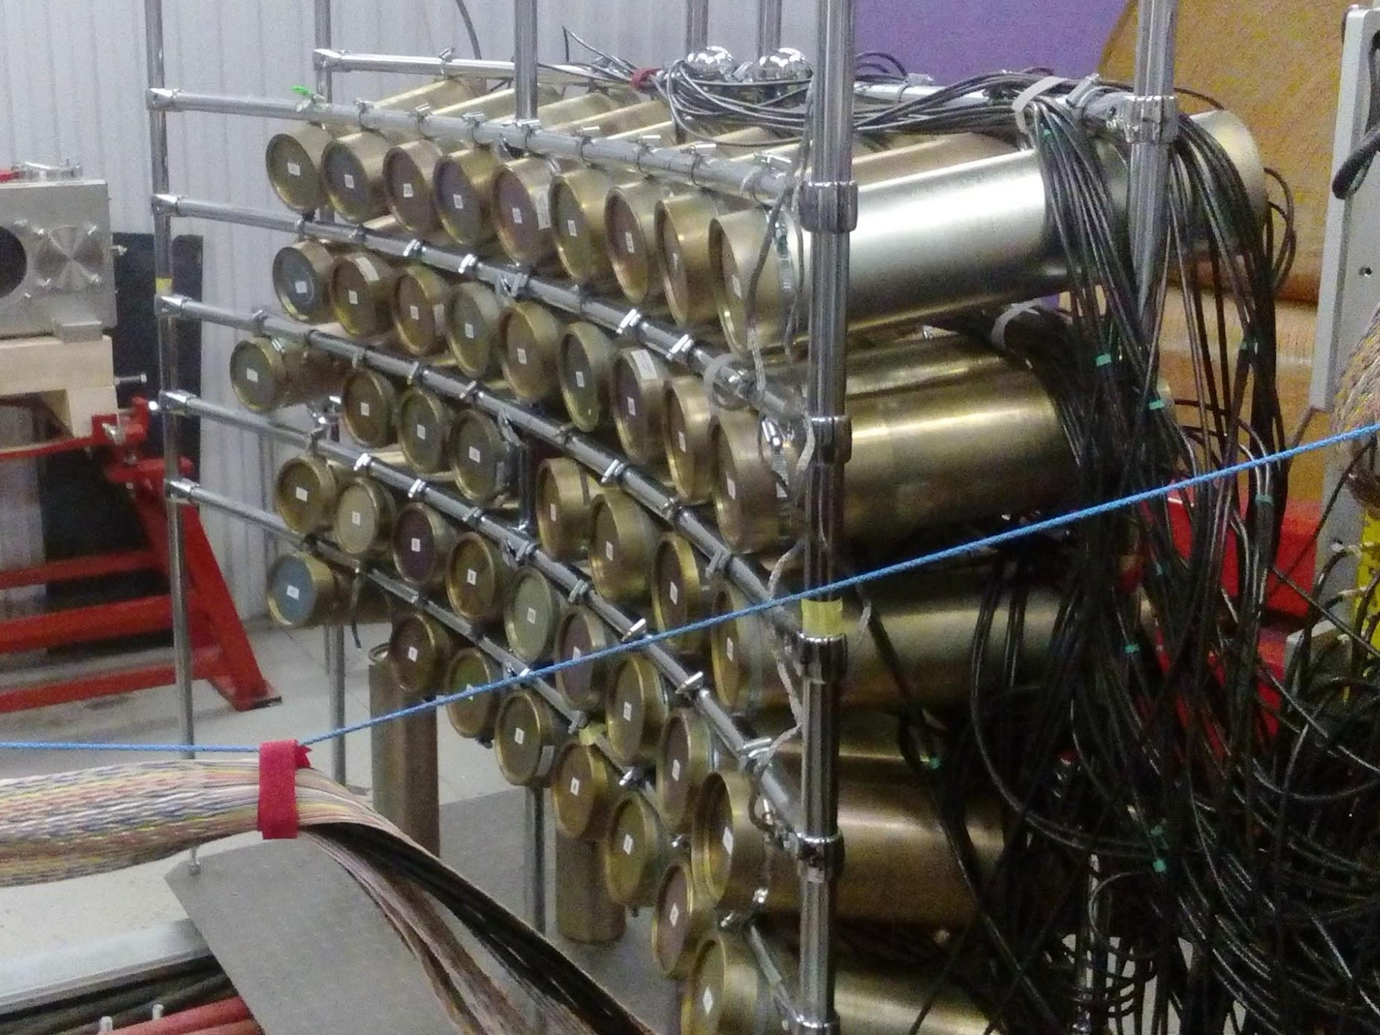
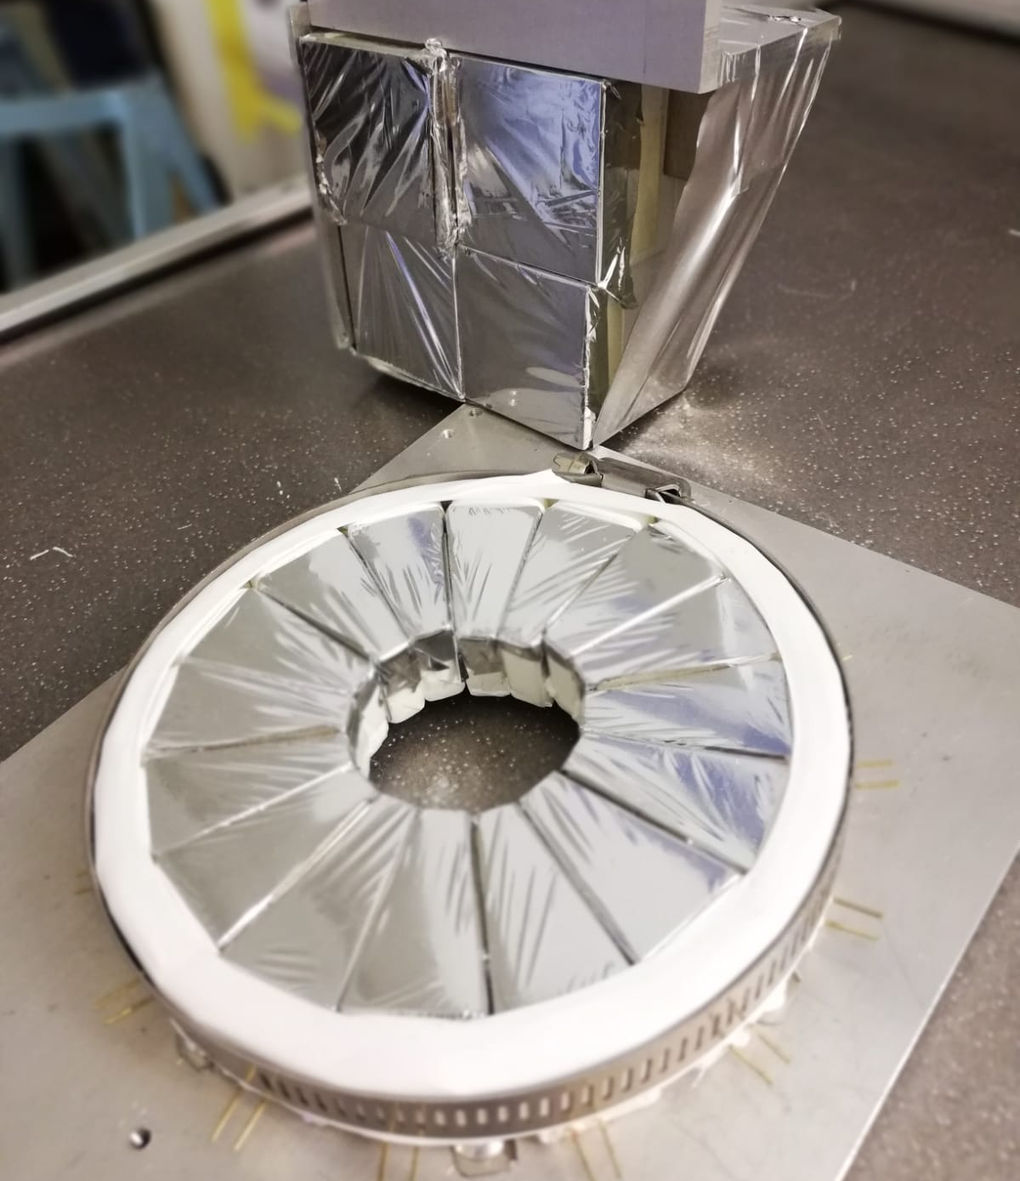
Detectors
ToF (Time of Flight) detector:
Plastic scintillator used to measure energy loss and time to cross a set distance
Silicon detector:
High resolution charged particle detection
Stilbene detector
CsI (cesium iodide):
One of the brightest known scintillating crystals
Stilbene detector:
High efficiency neutron detection

Slide 12
What did we do?

Slide 13
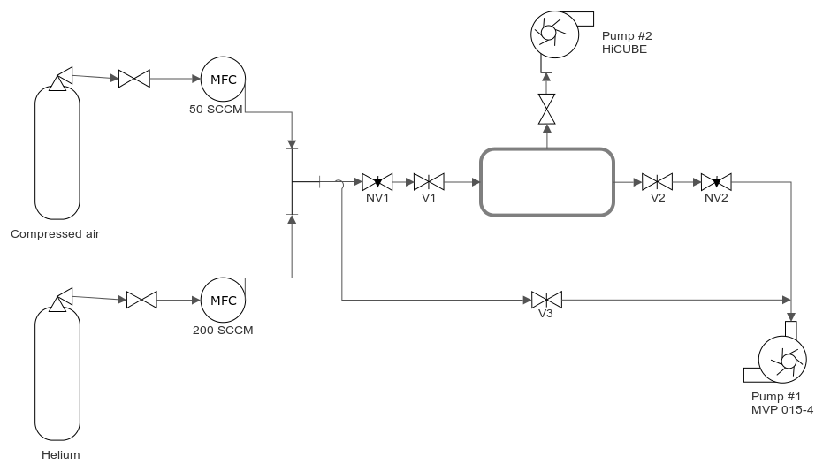
Construction of the gaseous system

Slide 14
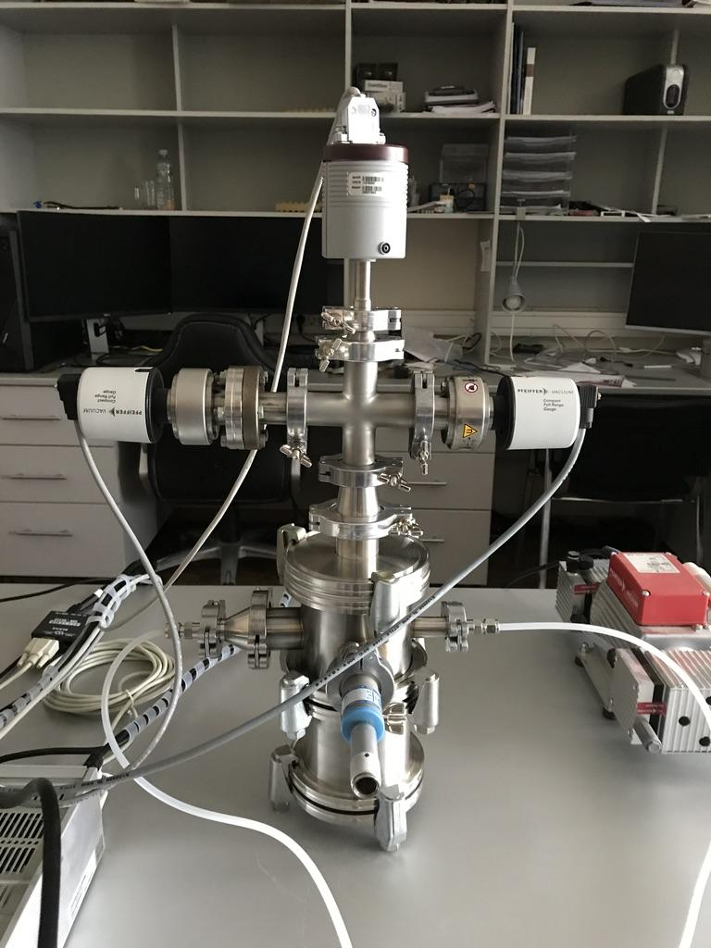
Chamber

Slide 15
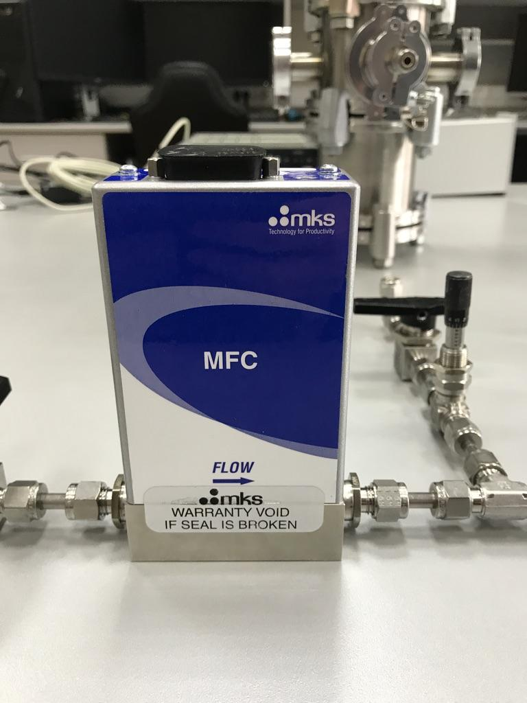
Mass Flow Controller

Slide 16
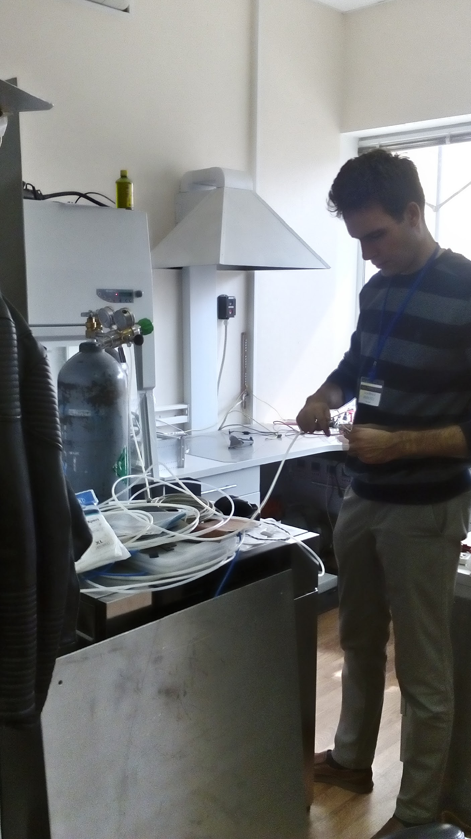
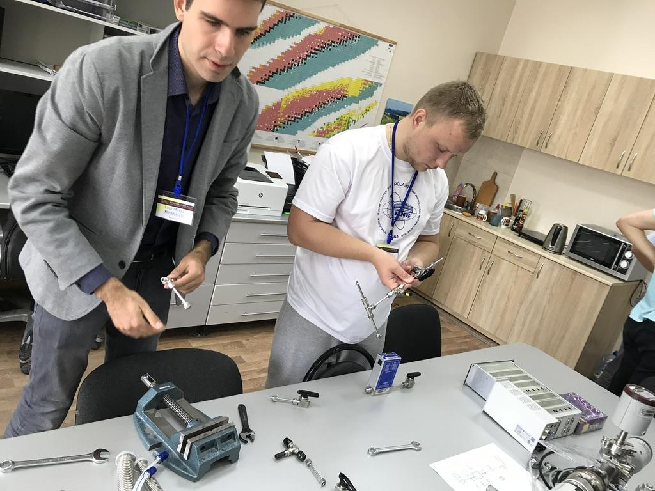
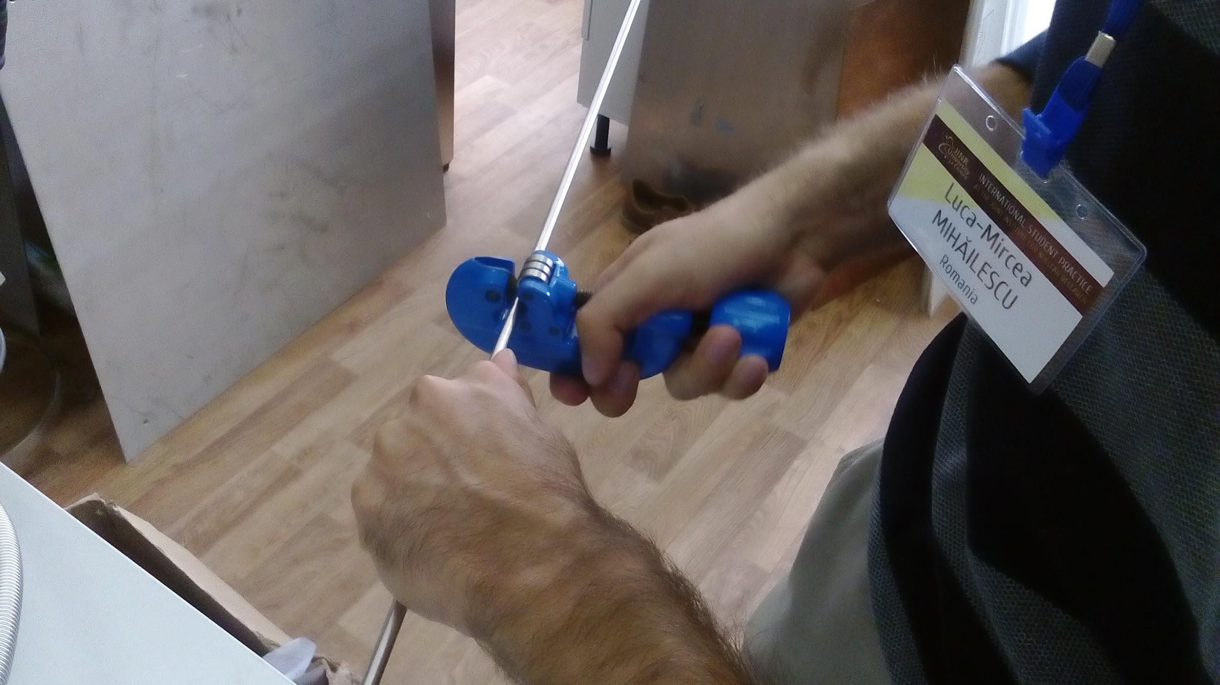

Slide 17
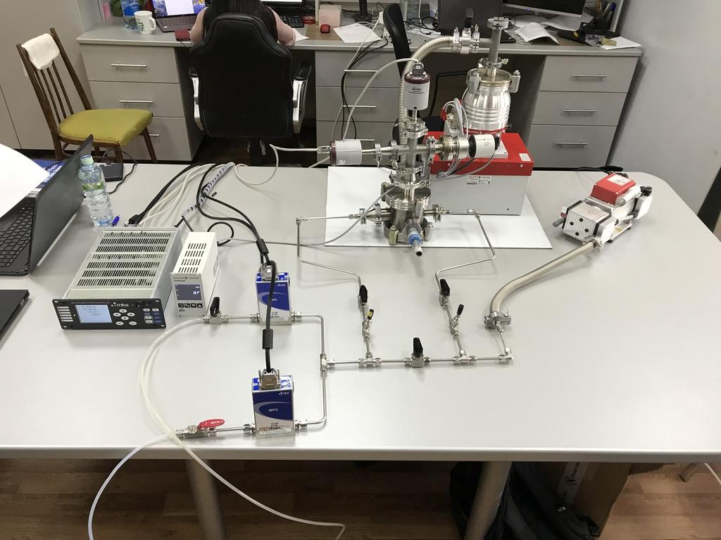

Slide 18
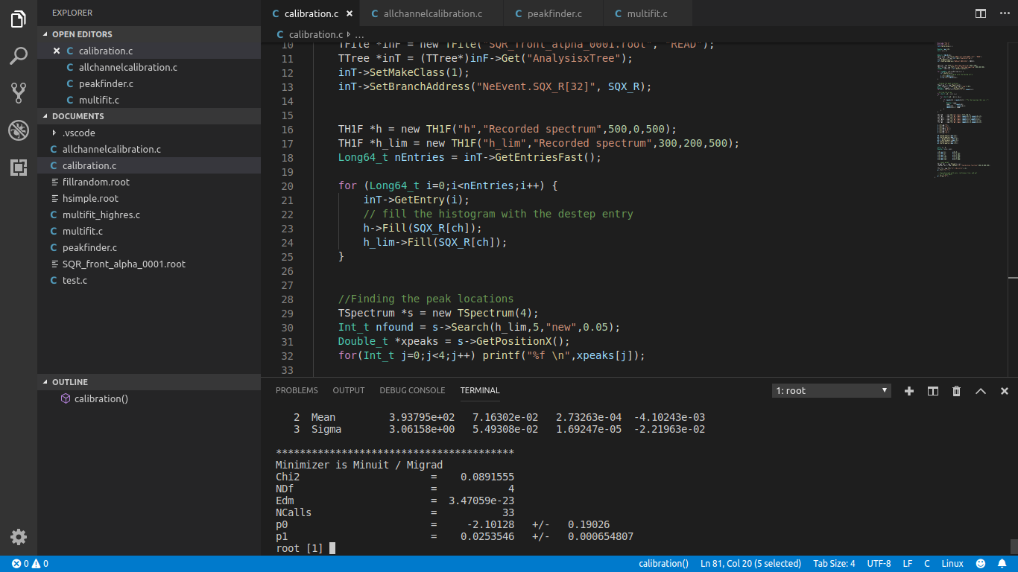
Implementing automatic silicon detector calibration

Slide 19
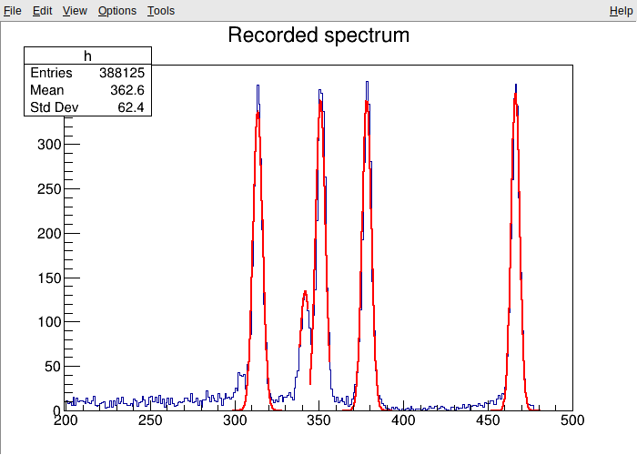
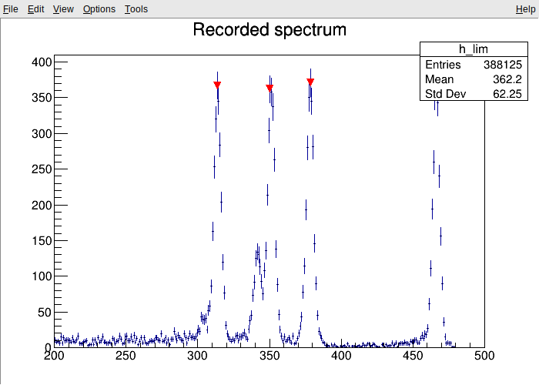
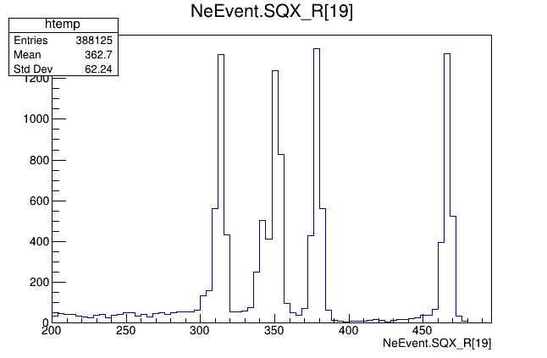
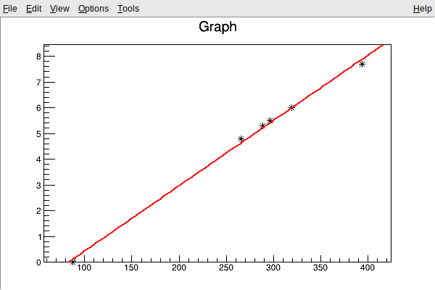
Analysis of ²²⁶Ra spectra
The script is built around the ROOT framework
Automatic identification the peaks in the spectrum using TSpectrum
Fitting a gaussian function in the vicinity of the peak in order to find the true peak
Correlating identified peaks with known energies of the alpha particles in the decay chain
The parameters of the linear fit are displayed in terminal
Execution takes ~10 seconds
E(x) = A+B*x
A = -2,1012
B = 0,0253

Slide 20
Conclusions
After the practice in Flerov Laboratory of Nuclear Reactions we:
have enriched our knowledge of nuclear physics,
are more experienced in experimental physics,
know the basics of working with the ACCULINNA separator,
are more proficient in data analysis.

Slide 21
Thanks for your attention!

